Slide 1

Predicting a 10-year risk of future coronary heart disease (CHD)
Business Analytics with R (MIS 6356.004)
Ravipalli Sai Sugun(RXS220117)

Slide 2

STATISTICS
Coronary heart disease (CHD) remains the top cause of mortality worldwide, accounting for a staggering 31% of all global deaths, according to the World Health Organization.
Besides the human toll, heart disease carries a significant economic burden, with an estimated annual cost of $351 billion in the US, encompassing healthcare expenses and lost productivity.
According to the American Heart Association, around 80% of heart disease cases can be prevented with lifestyle changes and managing risk factors.

Slide 3
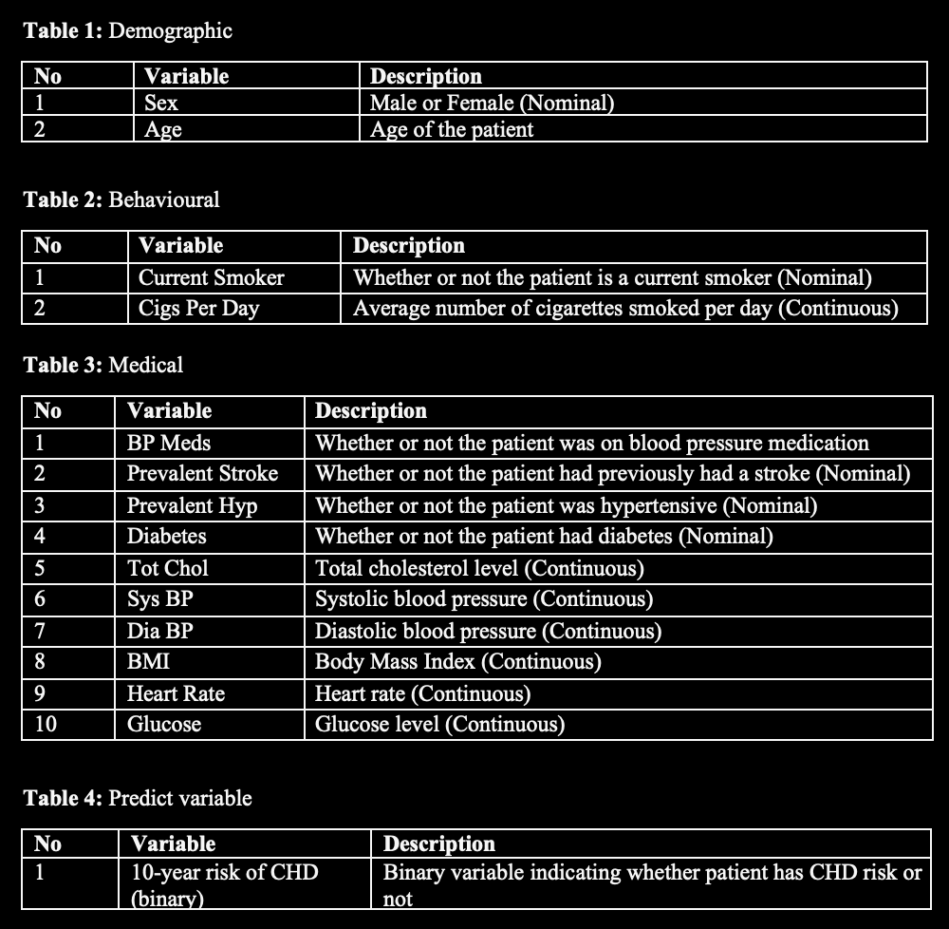
Dataset
Response Variable – TenYearCHD.
Numerical Predictors - Age, Cigs Per Day, Tot Chol, Sys BP , Dia BP, BMI, Heart Rate, Glucose.
Binary Predictors - Sex, Current Smoker, BP Meds, Prevalent Stroke, Prevalent Hyp, Diabetes.
Categorical Predictors - Education

Slide 4
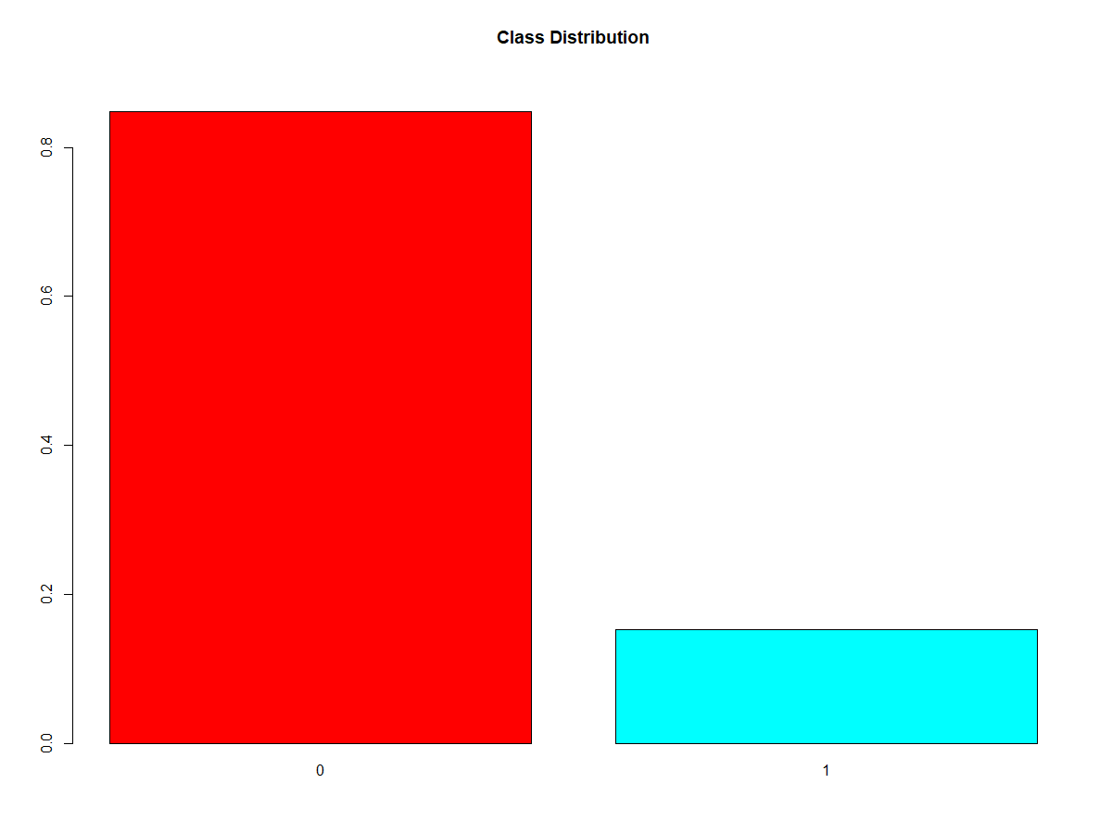
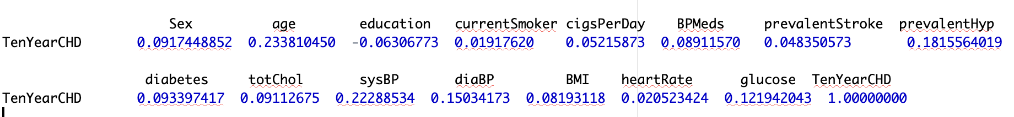
Procedure
Since the dataset is highly unbalanced and predictor variables having low correlation with Target variable. I used non-linear models like Decision Tree Random forest and Support Vector Machines along with Logistic Regression.
I used dimensional reduction for better performance changing the categorical variable to numerical class using one-hot encoding
Correlation:

Slide 5
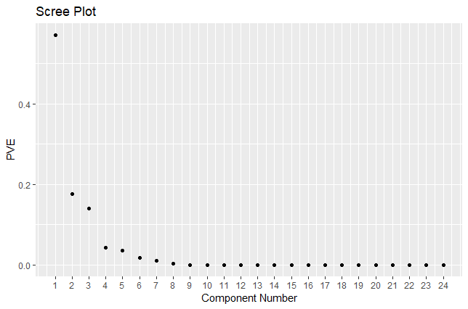
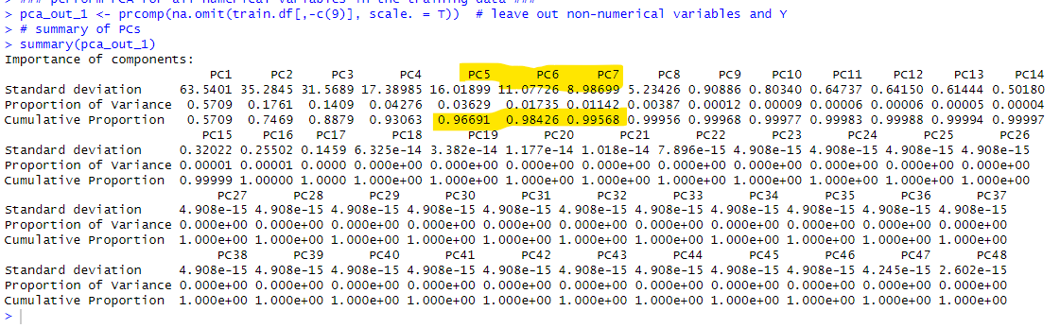
I utilized Dimensional reduction to check the best variables which captures the majority of data variance. - Feature selection will be done based on the scree plot and cumulative percentage.
Dimensional Reduction

Slide 6
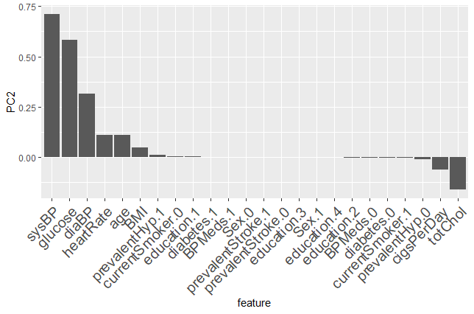
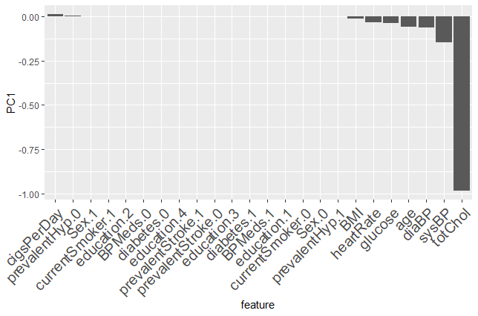
Dimensional Reduction

Slide 7
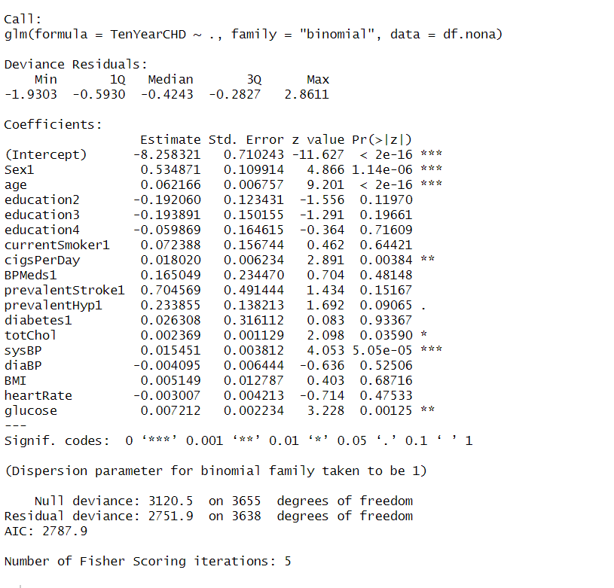
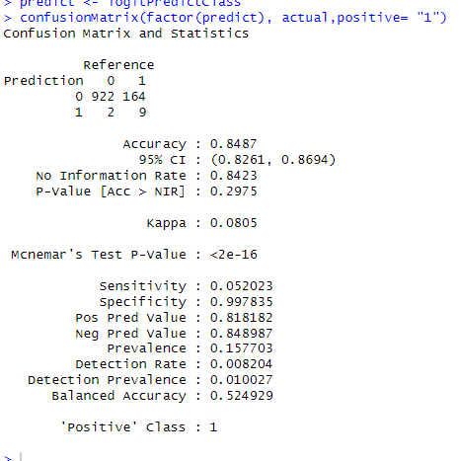
Non Linear Models before Dimensional Reduction
Logistic Regression

Slide 8
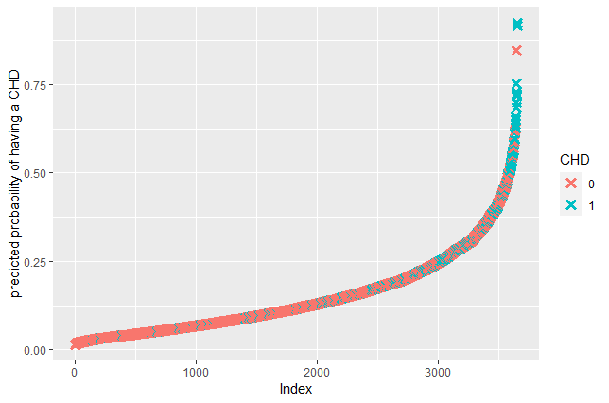
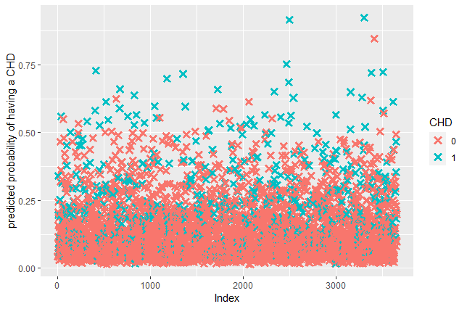
Logistic Regression results visualization

Slide 9
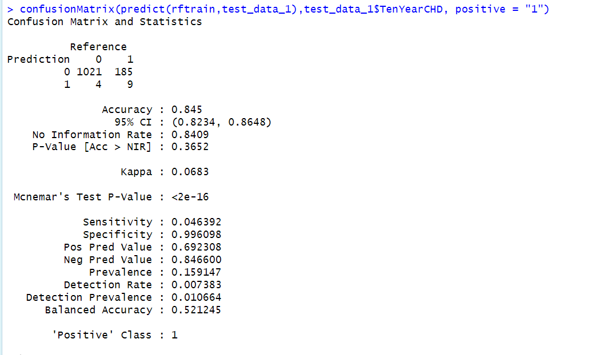
Random Forest without PCA or balancing techniques

Slide 10
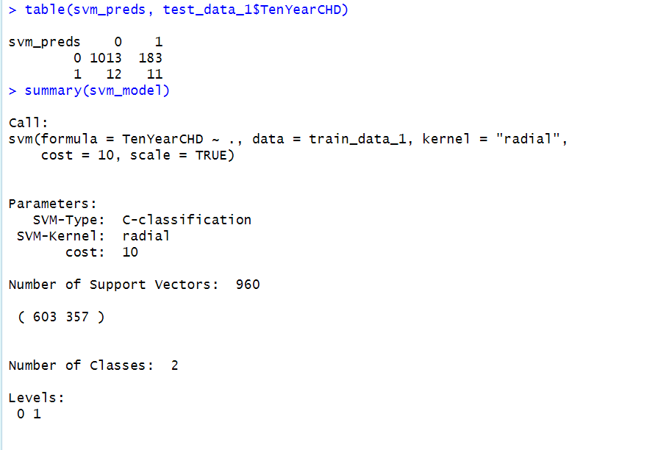
SVM without PCA or balancing techniques

Slide 11
Involving Balancing techniques
Oversampling:
When the data is imbalanced, i.e., one class has significantly fewer samples than the other, it can lead to biased models. Oversampling can help to balance the data.
Oversampling involves adding more samples of the underrepresented class to the dataset to balance the class distribution.
One way to oversample is to use the Synthetic Minority Oversampling Technique (SMOTE), which creates synthetic samples by interpolating between the feature vectors of existing samples.
Oversampling can be useful when there are few samples of the minority class, but it can also lead to overfitting and decreased performance on the validation set.
Undersampling:
In some cases, it may not be feasible to add more samples to the underrepresented class, so undersampling can be used to balance the data.
Undersampling involves removing samples from the majority class to balance the class distribution.
A common method for undersampling is random undersampling, which randomly selects a subset of the majority class samples.
Undersampling can be useful when the dataset is too large to oversample or when oversampling leads to overfitting, but it can also lead to loss of information from the removed samples.

Slide 12
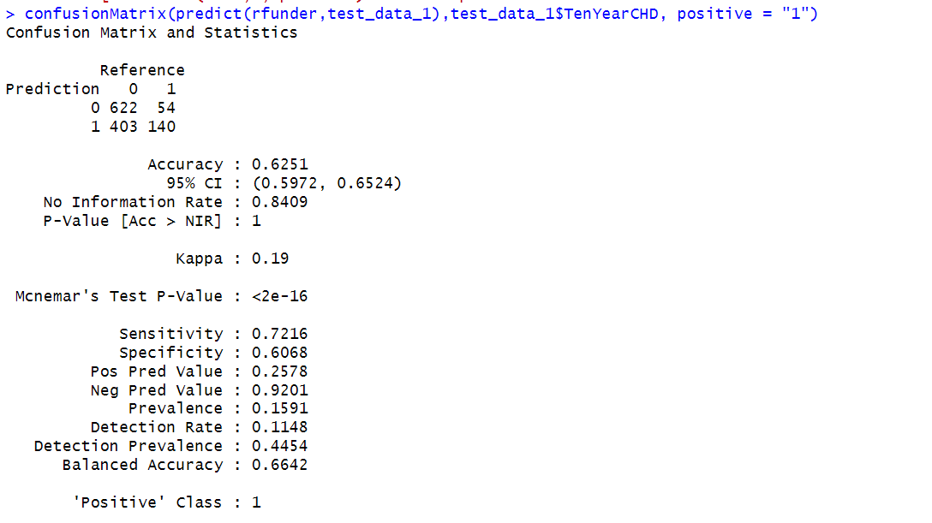
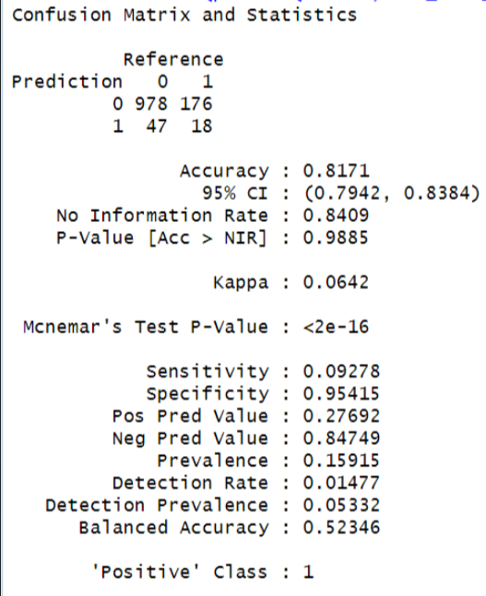
Random Forest with PCA balancing techniques
Under sampling
Over sampling

Slide 13
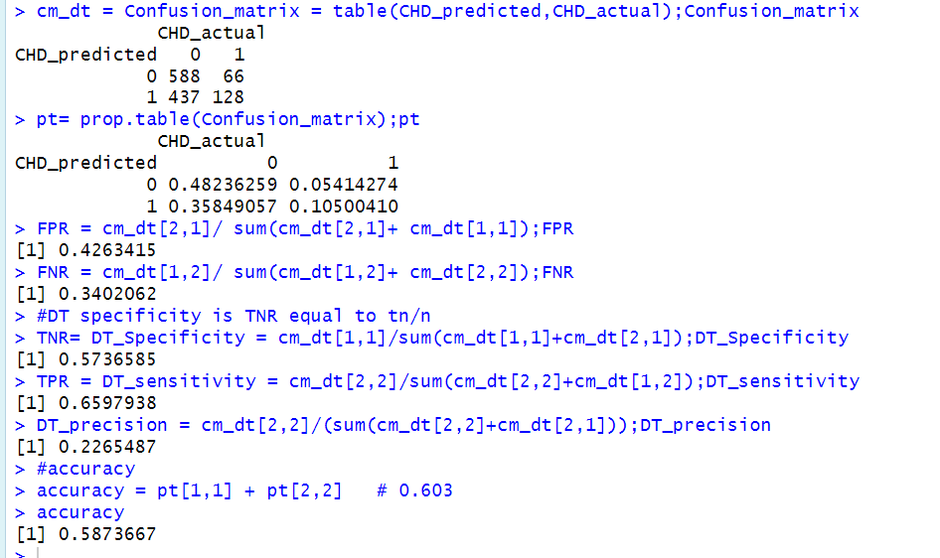
Decision Tree with PCA or balancing techniques

Slide 14
Conclusion
Coronary heart disease is a serious health concern that affects a significant portion of the population, but recent research has identified patterns and risk factors that can help to predict future risk.
Through the use of machine learning algorithms and techniques such as dimensional reduction and under sampling, this study was able to identify key health factors strongly associated with CHD and develop an accurate classification model to predict 10-year risk.
The results showed that the random forest algorithm outperformed other classification models in terms of sensitivity, recall, and precision, suggesting that this model could be a valuable tool for identifying patients at risk for CHD.
By providing early intervention or prevention methods, this model has the potential to help improve patient outcomes and reduce the burden of CHD on the healthcare system.
Above all the Models used random forest has given us better results in terms of sensitivity , recall and precision.

Slide 15
Business Solutions
A predictive model that detects heart disease offers valuable business solutions. Early detection and intervention of heart disease improves outcomes and reduces costs by up to 75%. The US spends $219 billion per year on heart disease.
Predictive models help assess risk and identify new treatments. Personalized treatment plans reduce hospital readmissions by 20%. Educating patients about risk factors and promoting healthy lifestyles can reduce the risk of heart disease by up to 80%. Invest in health for future dividends.

Slide 16
Challenges Faced
Unbalanced Data:
Our analysis aims to predict the risk of coronary heart disease using a dataset that presents a significant challenge.
The dataset is imbalanced, with only 15% of individuals having a risk of coronary heart disease, while the remaining 85% have no such risk. This poses a challenge because standard machine learning models may be biased towards the majority class, leading to lower predictive performance for the minority class.
Addressing this issue will require employing techniques such as data resampling or ensemble learning to improve the accuracy and robustness of our predictions.

Slide 17
Recommendations
Good food habits:
Fatty fish: Salmon, tuna, sardines, and mackerel are rich in omega-3 fatty acids, which can reduce inflammation and lower the risk of heart disease.
Berries: Blueberries, strawberries, and raspberries are high in antioxidants, which can help to reduce inflammation and lower the risk of heart disease.
Nuts: Almonds, walnuts, and cashews are high in unsaturated fats, fiber, and plant sterols, which can help to lower LDL (bad) cholesterol and reduce the risk of heart disease.
Whole grains: Oats, quinoa, brown rice, and whole wheat are high in fiber and can help to lower LDL cholesterol and reduce the risk of heart disease.
Vegetables: Leafy greens, broccoli, carrots, and sweet potatoes are rich in vitamins, minerals, and antioxidants that can help to reduce inflammation and lower the risk of heart disease.

Slide 18
Recommendations
Lifestyle habits:
Regular physical activity: Engage in at least 150 minutes of moderate-intensity exercise or 75 minutes of vigorous exercise per week to maintain a healthy weight, lower blood pressure, and improve heart health.
Healthy diet: Follow a diet rich in fruits, vegetables, whole grains, lean proteins, and healthy fats to maintain a healthy weight and reduce the risk of heart disease.
Avoid smoking: Smoking can increase the risk of heart disease, so it's important to avoid smoking and exposure to secondhand smoke.
Manage stress: Chronic stress can increase the risk of heart disease, so it's important to find ways to manage stress, such as meditation, yoga, or deep breathing exercises.
Regular health checkups: Regular checkups with a healthcare provider can help to detect and manage risk factors for heart disease, such as high blood pressure, high cholesterol, and diabetes.

Slide 19



Slide 20

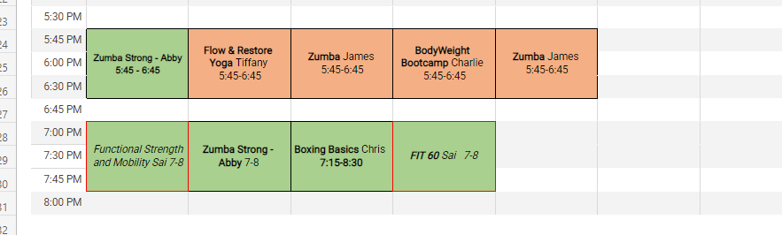
UREC Activity Center Programs

Slide 21
Thank You
"Investing in your health today will pay dividends tomorrow - because when it comes to wealth, nothing is more valuable than good health."

